Slide 1

AI in Sports Sponsorship: Reshaping an Industry
Ayan Sapru

Slide 2
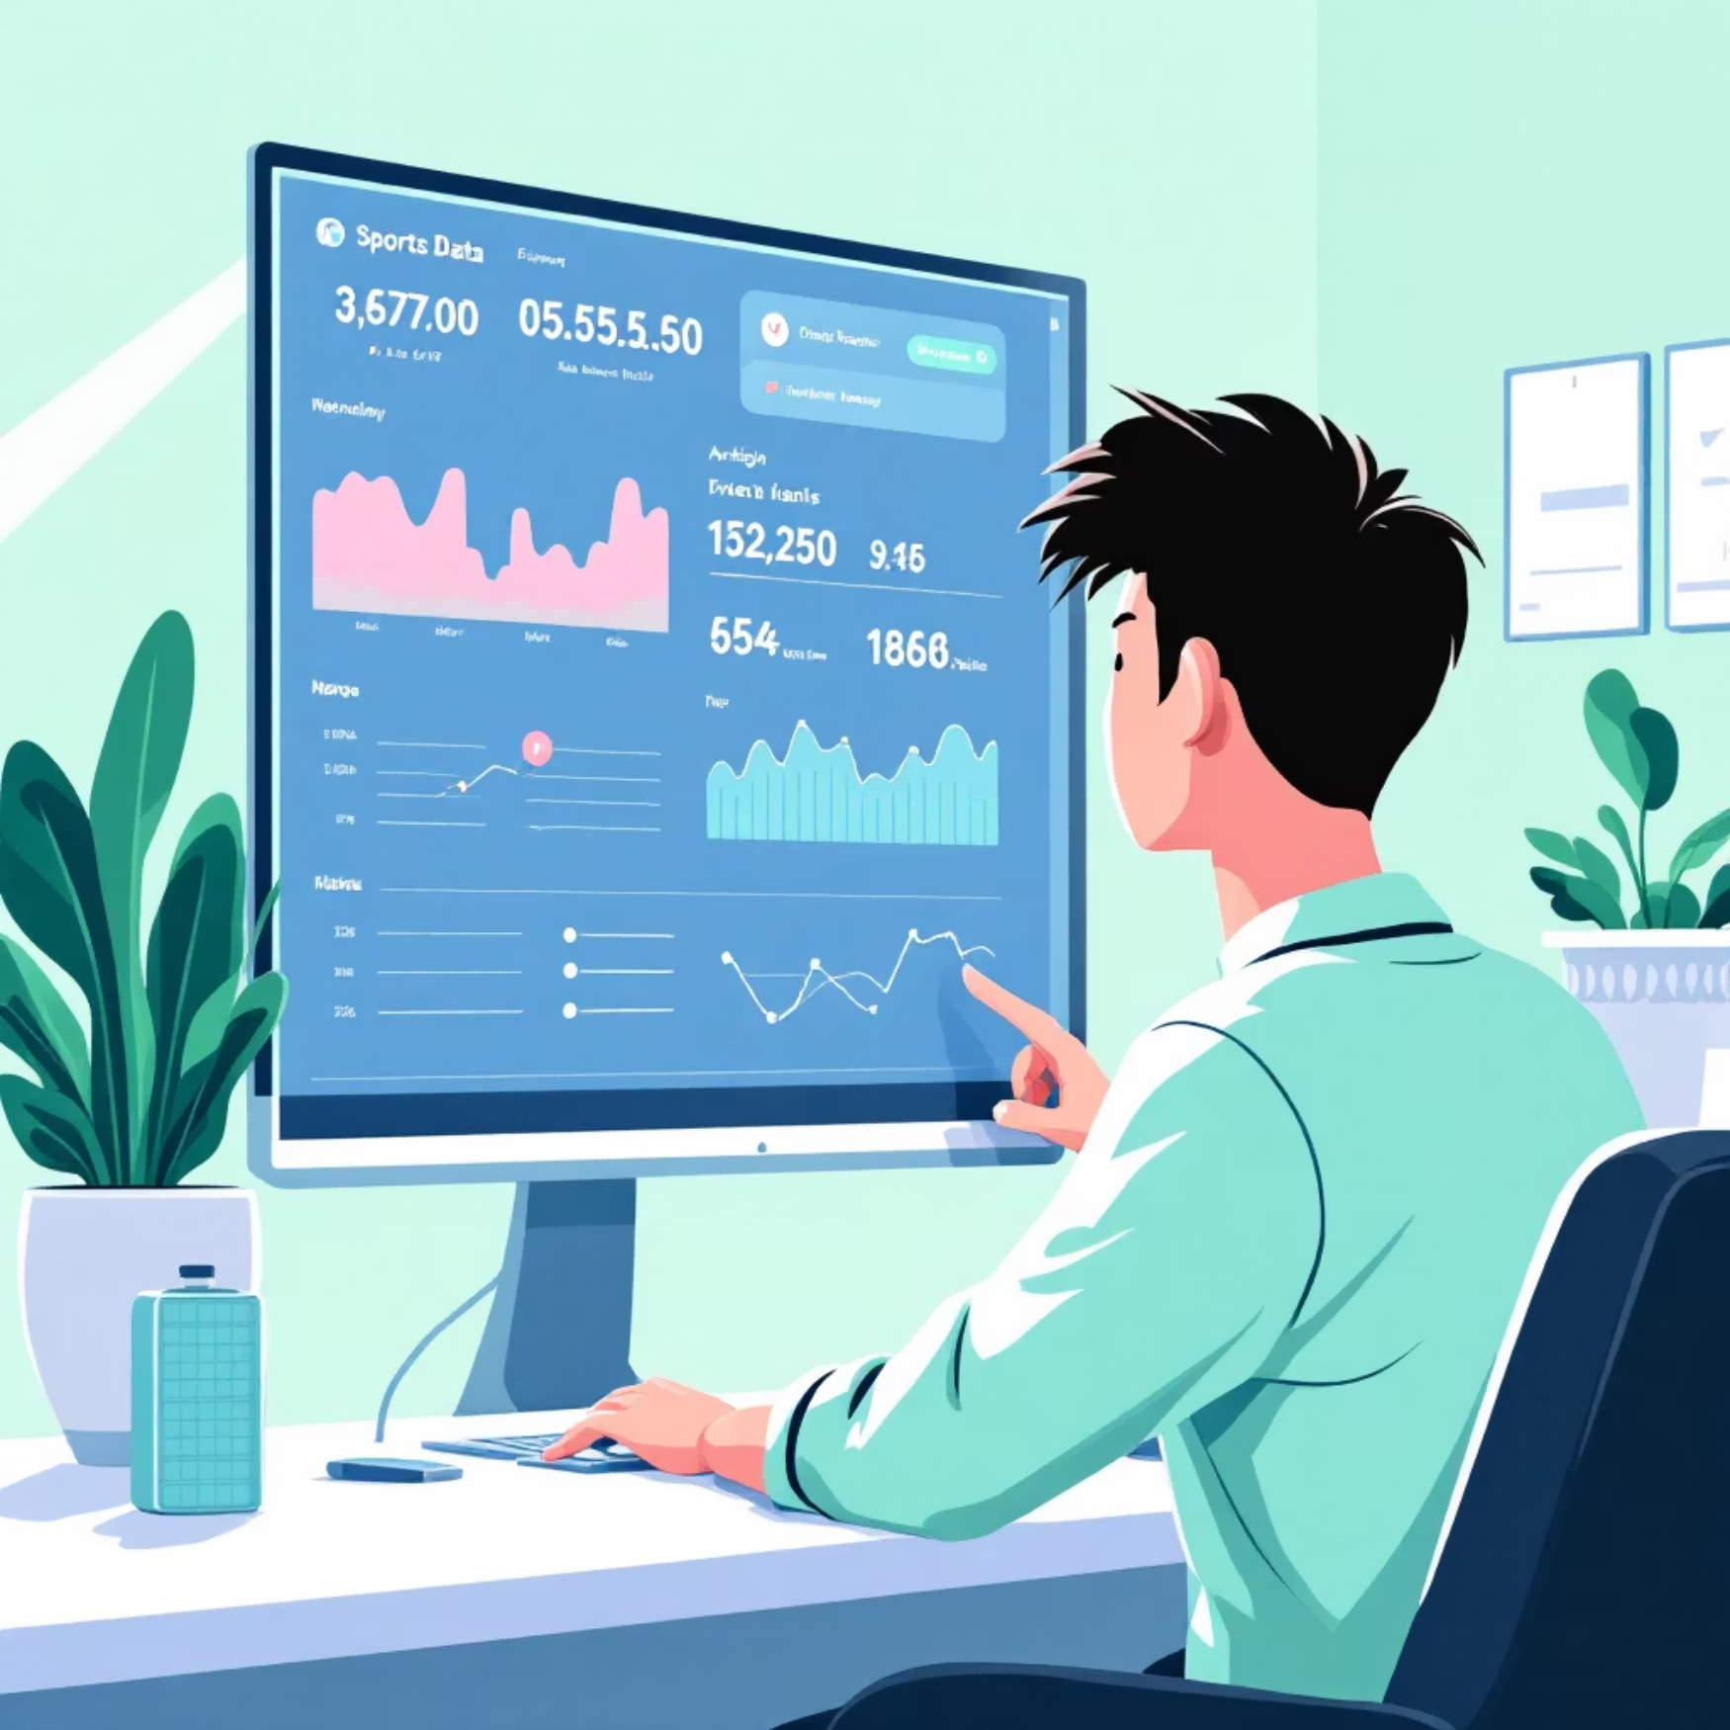
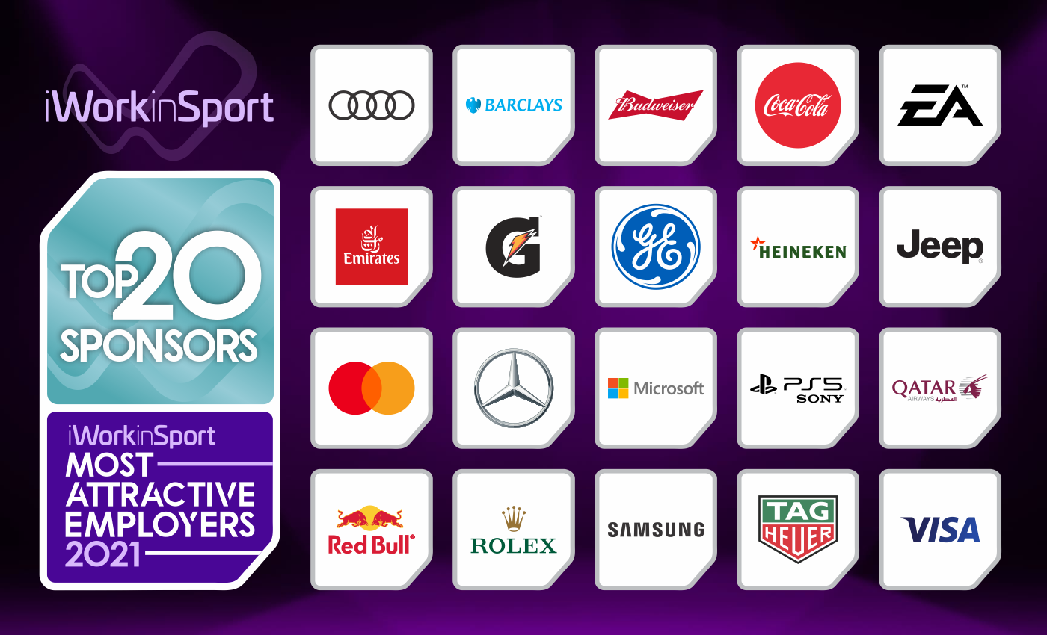
My Journey into Sports & AI
Why This Matters to Me
Why It Matters to You
My internships at PTSE, JSW Sports, and Sony Sports Network ignited my passion for sports business. I've always been fascinated by brand partnerships, athlete marketing, and sponsorship research. This project didn't just illuminate the industry; it helped me discover my place within its evolving landscape.
Sponsorship is rapidly becoming one of the most dynamic and fastest-growing segments of the sports business. Artificial Intelligence (AI) is at the forefront of this transformation, redefining how deals are valued, sold, and activated, with profound economic implications for all stakeholders.

Slide 3



Why Now? The Market Is Exploding
U.S. Market Surge
Global Market Projection
Growth Drivers
Global sports sponsorship grew from $105.5B (2023) to $114.4B (2024) (8.7% CAGR).
Projected to reach $185–190B by 2030.
PwC estimates the market will surpass $160B by 2030 led by major U.S. pro leagues. Key Point: The market is scaling rapidly — and accelerating.
More sports events + new global leagues
Broadcasting shifting to digital + streaming
Younger fans paying more for tech-driven experiences
AR/VR and virtual fan engagement opening new sponsor inventory
AI and analytics are reshaping who captures value
Data-rich teams/agencies gain pricing + targeting advantages
Smaller players risk falling behind Key Point: Growth is huge ,but uneven.
Key Insight: Sponsorship has evolved far beyond traditional advertising; it's now a sophisticated, data-driven revenue engine powering the sports economy.

Slide 4

Industry Snapshot: Sports Sponsorship Today
Size & Stage
Key Players
Sponsorship is in a strong growth phase, driven by global leagues, Name, Image, and Likeness (NIL) deals, and the surging popularity of women’s sports.
Brands: Nike, Adidas, Coca-Cola, PepsiCo, Microsoft
Agencies: Wasserman, Excel, Playfly, Octagon
Data Platforms: SponsorUnited, Nielsen
AI’s Industry-Level Impact
Reduces search costs between brands and properties
Improves pricing accuracy with AI valuation tools
Reshapes analyst roles with Python, visualization, and real-time analytics
Widest competitive gaps between data-rich and data-poor firms

Slide 5
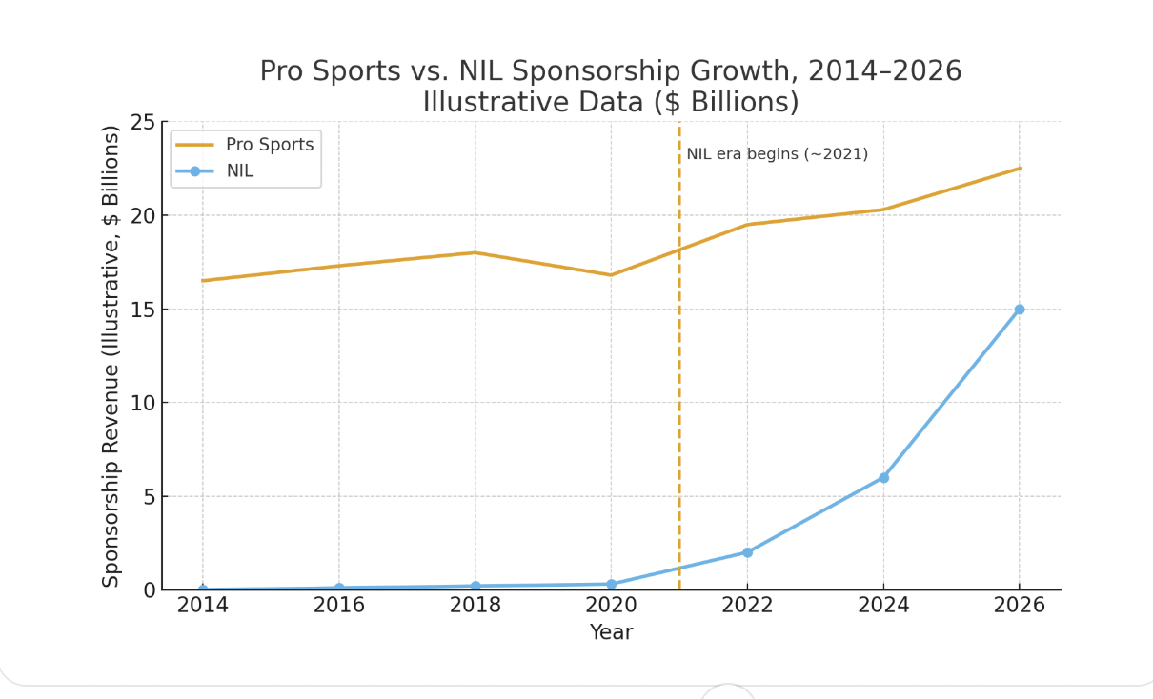
Sponsorship Trends: The Rise of NIL
This chart illustrates steady long-term growth in professional sports sponsorship, with a notable dip during COVID-19. The NIL market, however, shows an explosive trajectory post-2021, emerging as a structurally different, digital-first ecosystem enabled by AI tools rather than just an extension of traditional pro sponsorship.

Slide 6
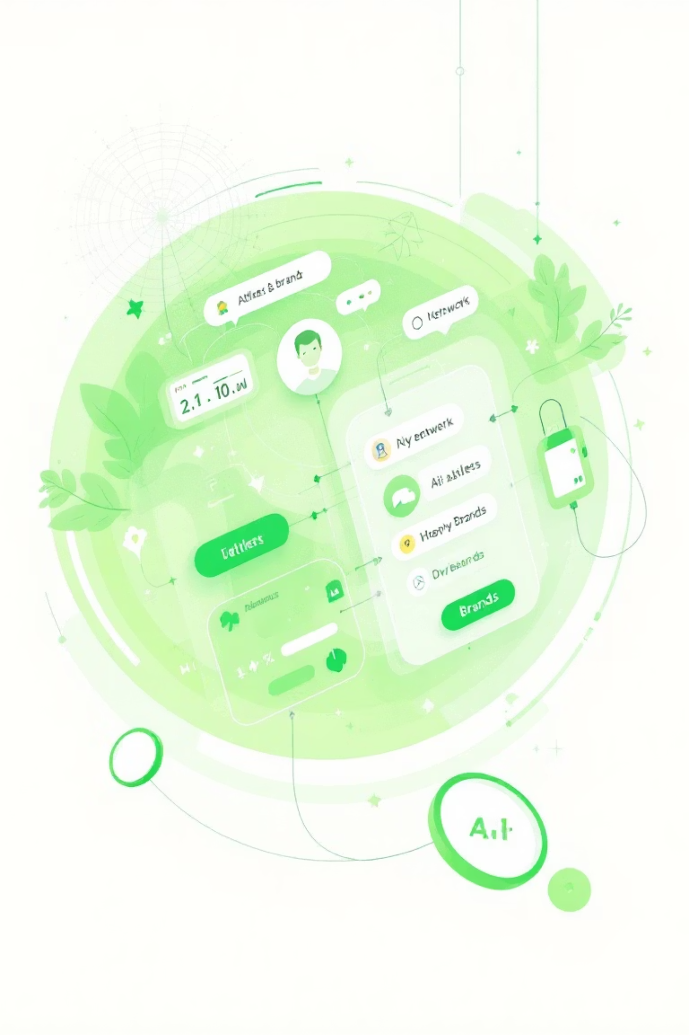



AI: The Catalyst for NIL's Rapid Scale?
AI Valuation Tools
AI algorithms accurately predict exposure, engagement, and fair market pricing for athletes, ensuring equitable and efficient deals.
Matching Algorithms
Sophisticated AI platforms connect brands with the ideal athletes at an unprecedented scale, optimizing partnership potential.
Reduced Search Costs
By minimizing discovery efforts, AI fosters more efficient markets, allowing brands and athletes to find optimal matches swiftly.
Economic Insight: AI didn't just accelerate the growth of NIL; it fundamentally reorganized how sponsorship value flows within the sports economy. AI reduces search costs between brands & athletes, Matching algorithms scale deals instantly

Slide 7
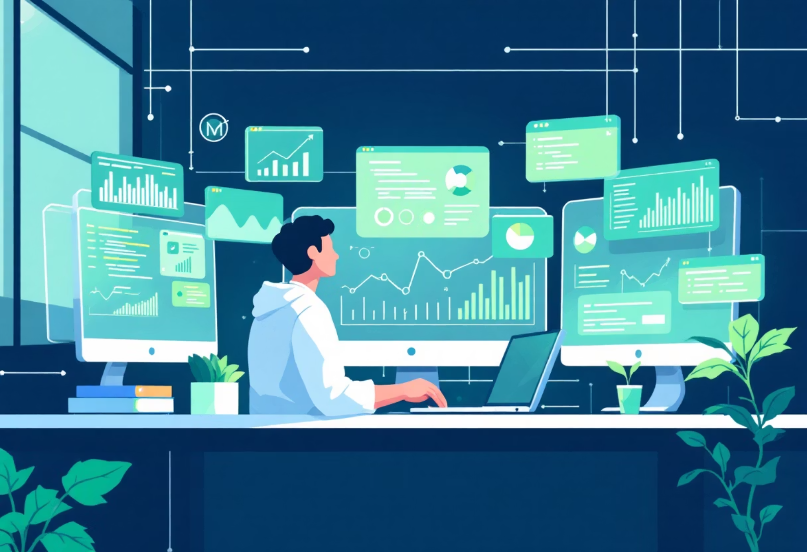

Generative AI: Reshaping Roles & Firms
Evolving Occupations
Transforming Firms
Sports analysts now require advanced skills in data visualization, Python programming, and sophisticated audience analytics. Partnership roles demand stronger storytelling capabilities coupled with expert data interpretation.
Teams and agencies leveraging AI gain significant pricing advantages and enhanced operational efficiency. This technological gap, however, risks creating disparities, as unequal access to advanced data tools widens the competitive divide between firms.

Slide 8




What I Learned
How My Thinking Changed
AI as an economic engine in sponsorship
Shift toward analytics + valuation career paths
Importance of validating AI outputs
Recognition that AI enhances analyst roles
How visuals + analytics strengthen industry storytelling
Greater confidence in data-driven economic explanation
How to use AI responsibly in research and communication
What Now Feels Possible
Building AI-assisted valuation tools
Pursuing Sponsorship Analyst / NIL Analyst roles
Producing portfolio work aligned with industry needs
This class helped me understand not just where the industry is going , but where I fit in it, and how AI can elevate my work in any sports business role.

